Slide 1
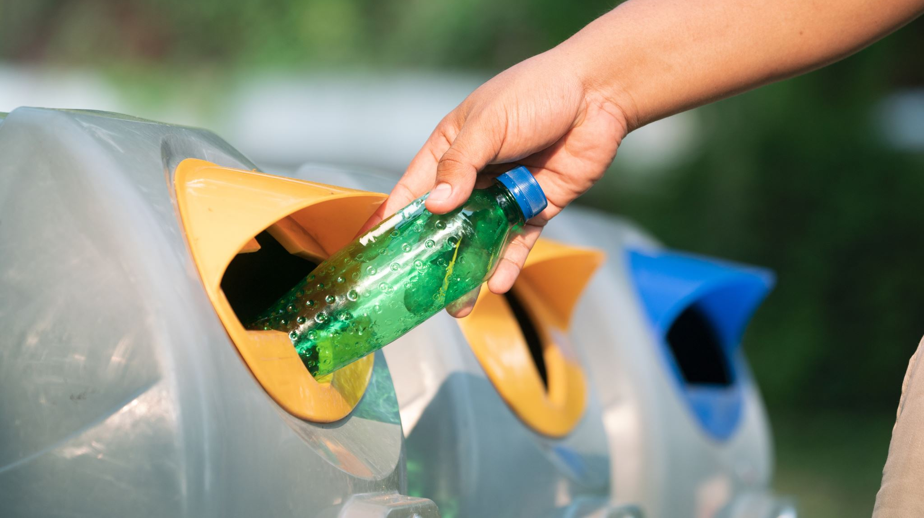
Smart dustbin
A Project By:
Lavanya Lakhiani

Slide 2

CONTENTS
INTRODUCTION
APPARATUS
PROCEDURE
CIRCUIT DIAGRAM
PROGRAM USED IN ARDUINO
PROGRAM USED IN SERVO MOTOR
WORKING
ADVANTAGES
CONCLUSION &SUGGESTIONS

Slide 3
INTRODUCTION
The rate increasing population in our country has increasing rapidly and also we have increase in garbage which have increased environmental issue. Dustbin is a container which collects garbage’s or stores items which recyclable or non-recyclable, decompose and non-decompose. They are usually used in homes, office etc, but in case they are full no one is there to clean it and the garbage are spilled out. The surrounding of a dustbin is also conducive for increasing the pollution level. Therefore, we have designed a smart dustbin using ARDUINO UNO, ULTRASONIC SENSOR and a SG90 SERVO MOTOR which will sense the item to be thrown in the dustbin and open the lid with the help of the motor. It is an IOT based project that will bring a new and smart way of cleanliness. It is a decent gadget to make your home clean, due to practically all offspring of home consistently make it grimy and spread litter to a great extent by electronics, rappers and various other things. Since the smart dustbin is additionally intriguing and children make fun with it so it will help to maintain cleanliness in home. It will be applied for various type of waste. Dustbin will open its lid when someone/object is near at some range then it will wait for given time period than it will close automatically. Here lid will close when you don’t want to use and it will only open when it required.

Slide 4

APPARATUS
To complete our project, we have used some software as well as some hardware.
1.1. Required Software:
1.ARDUINO IDE
1.2 Required Hardware:
1. ARDUINO UNO
2. ULTRASONIC SENSOR
3. SERVO MOTOR
4. 9V BATTERY
5. DUSTBIN
6. JUMPER WIRES

Slide 5
PROCEDURE
SERVO MOTOR CONNECTION SETUP:
Now, let us take you through the actual setup and build process of the Smart Dustbin using Arduino. First, I will start with the mechanism to open the lid. As you might have already guessed, I have used a Servo Motor for this purpose. To open the lid, I have fixed a small plastic tube (like an empty refill of a ball-point pen) to the servo horn (a single ended horn) using instant glue. For this mechanism to be able to open the lid of the dustbin, it must be placed near the lid, In this the actual setup of dustbin design and build the system by using Arduino. Starting with the mechanism of opening the lid of dustbin, for this purpose Servo motor has been used. To open. the lid, I have attached a small plastic tube (like an empty refill of a ball-point pen) to the servo horn (a single ended horn) using instant glue.

Slide 6
ULTRASONIC SENSOR CONNECTING:
After successfully servo motor is placed now it's time for sensor, so HC-SR04 Ultrasonic sensor is placed at the front of the dustbin. To complete our project, we require some.
WIRING UP THE COMPONENTS: The final step in the build process is to make the necessary connections using long connecting wires as per the circuit diagram and securing these wires so that they don't hang around. All the wires from both the components i.e. Ultrasonic Sensor and Servo Motor are connected to respective pins of Arduino. This finishes up the build process of the Smart Dustbin. In Arduino Code has been submitted, and with all hardware and software connection in dustbin.

Slide 7

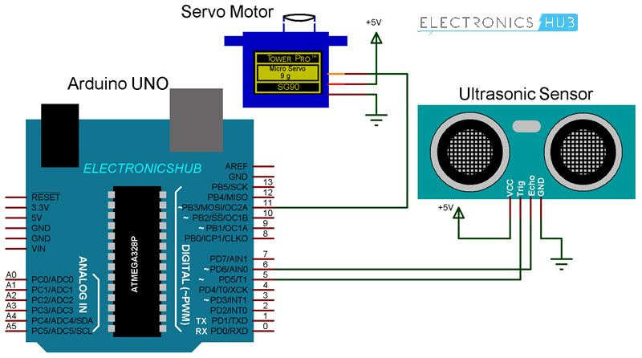
CIRCUIT DIAGRAM

Slide 8
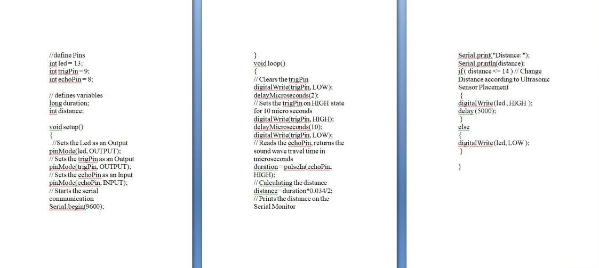
PROGRAM USED IN ARDUINO

Slide 9
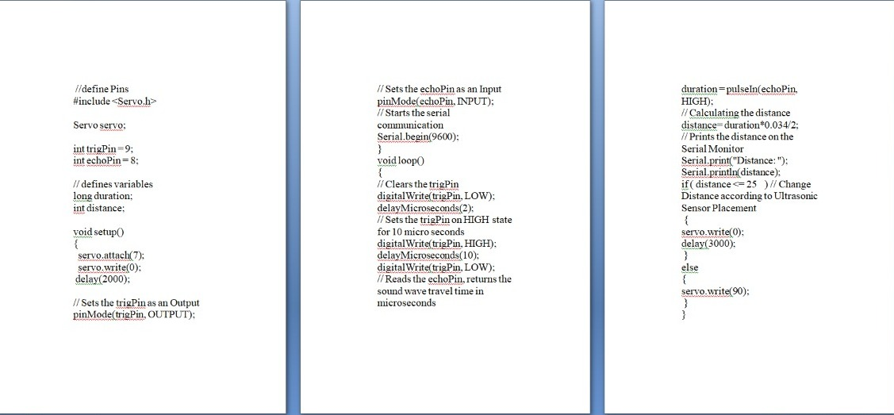
PROGRAM USED IN SERVO MOTOR

Slide 10
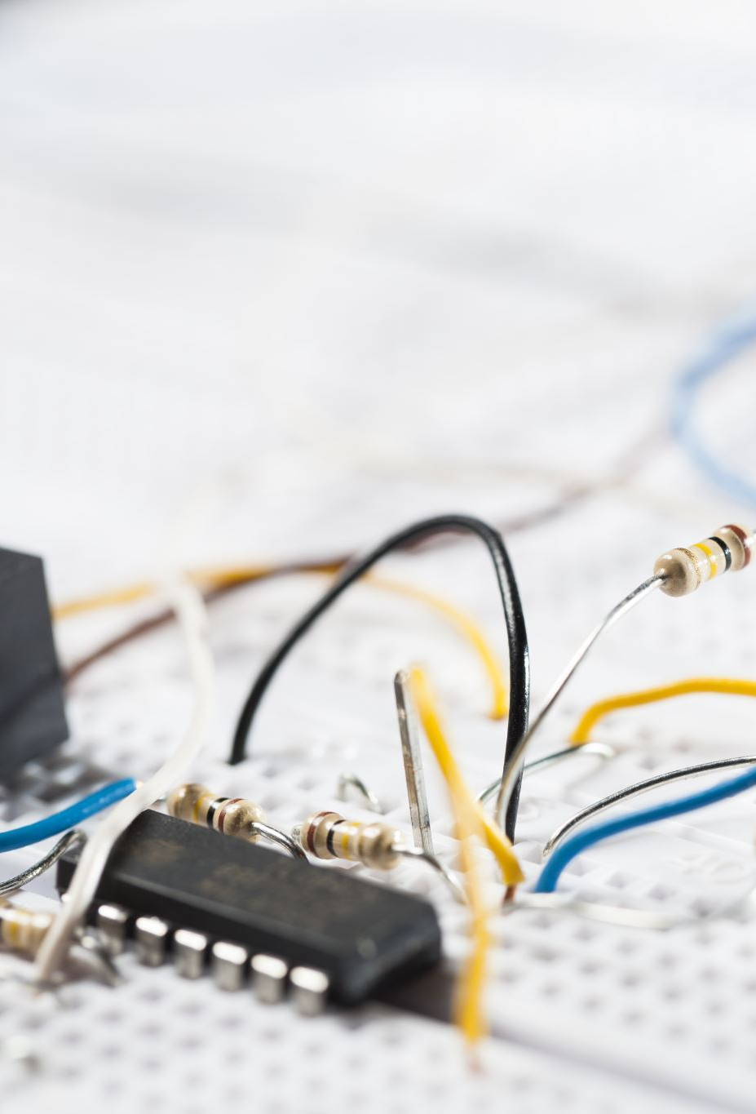
WORKING
After wiring and attaching all the devices and setting up to the Smart Dustbin, now observe all the important setup whether they are well connected or something missed.
After connection set up now next step is to submit/upload code in Arduino and supply power to the circuit.
When system is powered ON. Arduino keeps monitoring for any things that come near the sensor at give range.
When Ultrasonic sensor detect any object for example like hand or others, here Arduino calculates its distance and if it less than a certain predefines value than servo motor get activate first and with the support of the extended arm of the lid. Lid will open for a given time than it will automatically close.

Slide 11
ADVANTAGES
Following are the advantages of a smart dustbin:
•A reduction in the number of waste collections needed by up to 80%.resulting in less manpower, emissions, fuel use and traffic congestion.
• A reduction in the number of waste bins needed.
•Maintain environment hygiene (i.e. no overflowing of waste and less unpleasant odour).
•It will help in bringing evolution by technology in term of cleanliness.

Slide 12
CONCLUSION & SUGGESTIONS
Here we are going to make an evolution changes. toward cleanliness. The combination of intelligent waste monitoring and trash compaction technologies, smart dustbins are better and shoulders above traditional garbage dustbin. It is equipped with smart devices like sensor Arduino etc. Lid of the dustbin will automatically open when an object comes near to the dustbin and after certain time period it will close the lid.
For social it will help toward health and hygiene, for business for we try to make it affordable to many as many possible. So that normal people to rich people can take benefit. from it. Believe this will bring something changes in term of cleanliness as well technology. So our next work will be adding one more sensor which will sense whether our dustbin is full or not. And there will be a display will be added so that user can notify that dustbin is full or not.

